Slide 1

MICROSOFT POWERSHELL TRAINING
Ryan Schlagel / Technical Lead
Wendy Peterson / Senior Systems Engineer
Dustin Giles / Systems Engineer
June 3, 2013

Slide 2
How did we get here?

Slide 3
Challenges
Multiple languages
Support For Legacy Code
Remoting
Various Technologies Used
Firewall Friendly?
Code Locations
Multiple Locations
Versioning?
Notes:
http://www.youtube.com/watch?v=cZh105_r2Qk
Multiple Languages
- Multiple languages require various dependencies (e.g. Perl requires ActivePerl)
- Supporting legacy code is always challenging if there is no consistancy in language (bash, perl, python, powershell, vbscript, AutoIT, etc.)
Remoting
- No consistency in technologies being used (some secure and some not) (e.g. PSExec, RPC, WMI)
- Some technologies are not firewall friendly (WMI, RPC)
Code Locations
- Saving code in multiple locations is always a challenge because your forced to search multiple locations to find what your looking for
- No Versioning
- Snippet Repository
- Multiple versions of the same code

Slide 4
Project Team Established
Standards
Language
Remote Management
Processes
Peer Code Review
Training
2 Week Training
Central Management
Script Execution Point
Refreshed Hardware
Better Tools
Scripting Editor
Code Repository
Repository

Slide 5
Standards
Language
Microsoft PowerShell 3.0
PowerShell is both a interactive shell and a scriptable language
Remote Management
Windows Remote Management (WinRM)
Integrated with PowerShell 2.0 and higher
Robust / Flexible / Secure
Easy Firewall Management
Repository
Mercurial
Distributed Model
Branching Support
In-house Expertise
Free
Microsoft Road Map

Slide 6
Processes
Peer Code Review
Learning Opportunity
Stability
Coding / Process Consistency
Notes:
Learning opportunity for engineers by having their code criticized by a more advanced scripter.
Stability by having someone review your code. Finding problems prior to deployment is always a positive.
Coding / Process Consistency – By having someone review your code, it should help keep processes and coding consistent between coders

Slide 7
Tools
Scripting Editor
Dell / Quest PowerGUI
Code Repository (Version Control, Snippets, etc.)
Mercurial

Slide 8
Infrastructure Updates
Components | Affected Assets
Upgrade / Configure WinRM | 2,239 Assets
Install / Upgrade PowerShell 2.0 | 3,394 Assets

Slide 9
Training
PowerShell Training
Week 1: Monday, Wednesday, Friday (AM / PM)
Week 2: Monday, Wednesday, Friday (AM / PM)
2 Hours Per Day
Open Discussion
Week 1: Friday (PM)
Week 2: Friday (PM)
1 Hour
Training Modules
Module 01: Introductions
Module 02: Fundamentals
Module 03: Pipeline
Module 04: Scripting
Module 05: Security
Module 06: Object Models
Module 07: PowerShell Remoting
Module 08: Error Checking and Debugging
Module 09: Active Directory / SQL
Module 10: Resources
Module 11: Scripting Editor
Module 12: Source Repository
Module 13: Template Use

Slide 10
Business Objective / Deliverables
Experience / Advancement
Standards
Processes
Training
Centralized Management
Efficiency
Better Tools
Knowledge Sharing
Notes:
Establish New Standards
- Ease of management through new tools and standards (WinRM)
- Standardized on:
- Language
- Versioning Control
Peer Review Process
- Stability
- Mentoring / Teaching
Training
- In-House Training
- Everyone gets trained
- Training on language, tools, processes
- Code Deployment Techniques
Collaboration Tools
- Repository – place to store and share your content with protection and versioning control. Will also include snippet repository
Updated Assets For Central Management
- Two new assets that will include access into secured environments

Slide 11
Sampling of Scripts Written So Far…
Setting Disk Timeout
MS12-020 Rollout
MS11-100 Rollout
Patch Audit
WinRM Audits
Cobalt NodeAgent Deployment
IIS Deployment
IIS Advanced Logging Deployment
SMTP Deployment
FTP Deployment
NTP Settings
HubbardOne Build Scripts
.NET Installation
Configure IIS Global MIME Settings
Install and Configure MSMQ
Configure ASP.NET Security
Create IIS Application Pools
Continuous Maintenance
Web Service for Service Manager
Configure ASP.NET Trusts
Create New Company For Litigation Hosting (Active Directory)
Quantify Active Users for Litigation Hosting
Set Folder Permissions
Asset Decommission Process
Configure NTFS Permissions
Enable/Disable RDP
Installing MSXML6
Install Microsoft SOAP 3
Update Boot.ini
Updating Default IIS Log Location
IIS Advanced Logging Zip and Delete Tool
Update DNS Configuration
Update WINS Configuration
Configure TimeZone
Asset Lookup Utility
Microsoft Audit
Avamar Deployment
Source IP Deployment
Source IP Auditing
Converting Patch Profile ID’s to Validate Date/Time
TEM Patching Projection Tool
Audit for 1024 Certificate Keys
Resetting Local Administration Passwords
Project Faraday Data Gathering
Litigation Hosting - User Creation Using CSV
VMWare Tool Audits
Scan for SQL Versions
SMS Retirement Scripts
HP Enclosure Utility
Avamar DPA Lookup Utility
Locating an elevated service account
TEM Data Collection

Slide 12
Training

Slide 13
Expectations / Goals
Format - 30 min lecture / 30 min lab
This presentation is NOT meant to be a comprehensive/complete tour of the PowerShell language.
Provide the groundwork / basic fundamentals allowing an engineer PowerShell independence
Best Practices
Discuss Standards / Processes
Educate on new toolsets
Going to use chat
We are engineers
Notes:
This presentation is NOT meant to be a comprehensive/complete tour of the PowerShell language.

Slide 14
Module 1: Introduction
Ryan Schlagel

Slide 15
Why Invest in Scripting?
Automation
Automate repetitive (boring) tasks
Only Human
Consistency
Machines work all night / Humans get tired
“Never send a human to do a machine’s job” – Agent Smith
Speed
Computers are always faster!
Provides Lasting Value
Scripts can be re-used
Notes:
http://scriptlore.com/why-learn-to-script/
Automation: Compare working an all nighter with doing the same with a one-liner (Bart writing “Shooping paintballs is not an art form”)
Only Human: Get tired, bored, limited hours => start making mistakes and redoing work (non-productive) and rarely appreciated
Speed: Installing XP from a disk and not having to wait for the prompts
Provides lasting value: Reuse scripts, quick runs, instant / concise results
Hugo Weaving (Agent Smith) – The Matrix

Slide 16
Old vs. New
Revolutionary Language
GUI
Scripting
Interactive Command Shell
 | Before | Now
GUI | MMC | GUIs built on top of PowerShell
Interactive Shell | CMD | PowerShell
Scripting | BAT in CMD | PowerShell
COM Scripting | WMI (VBScript / Jscript) | PowerShell
Notes:
COM: Component Object Model

Slide 17
What is it?
Definition - PowerShell, formerly known as Monad, is both a powerful interactive shell and a programming language / scripting language from Microsoft.
Versions
PowerShell v1
Released in November, 2006
PowerShell v2
Released in 2009
Significantly More Features
PowerShell v3
Released September 12, 2012
Significantly more cmdlets and features

Slide 18
Features
C# Type Syntax
Access to cmdlets providing access to .NET Framework classes
Support for regular expressions
A provider model that provides Windows PowerShell with access to hierarchical repositories (Registry, FileSystem, etc.)
Shorthand Support
Some Unix/Linux commands available

Slide 19



Authors
Jeffrey Snover
Architect
Microsoft Corporation
Bruce Payette
Principal Software Design Engineer
Microsoft Corporation
Jim Truher
Program Manager
Microsoft Corporation
Notes:
Initial Release: November 14, 2006
Stable Release: September 4, 2012
Influenced by: Ksh, Perl, c#, CL, DCL, SQL, TCL and TK

Slide 20
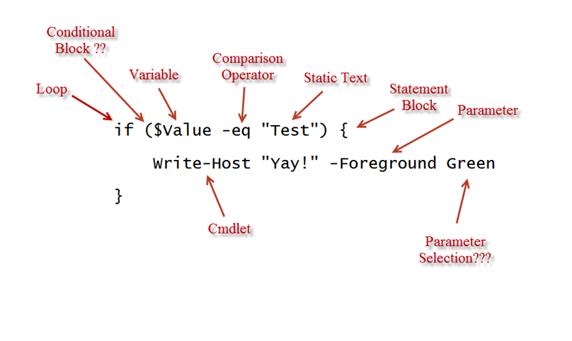
Introduction To Powershell

Slide 21
How Do I Identify PowerShell Code?
File Extensions
PS1 – Windows PowerShell shell script
PS1XML – Windows PowerShell format and type definitions
PSC1 – Windows PowerShell Console File
PSD1 – Windows PowerShell data file (v2 only)
PSM1 – Windows PowerShell module file (v2 only)

Slide 22
Application Support / Integrations
External software vendors develop PowerShell Snap-In / Modules
Application | Cmdlets
Microsoft Exchange Server 2010 | 402
Microsoft Windows Server 2008 R2 | 410
Microsoft Windows Server 2012 | 1160
Microsoft SQL Server 2008
Microsoft SQL Server 2012
Microsoft System Center Operations Manager | 74
VMWare vSphere PowerCLI | 370
Microsoft Internet Information Services 7.0 | 54
Microsoft Internet Information Services 7.5 | 74
Microsoft Internet Information Services 8.0 | 79
NetApp Data ONTAP PowerShell Toolkit | 1158
Notes:
Revolutionary: Radically new or innovative; outside or beyond established procedure, principles, etc.

Slide 23
Module 2: Fundamentals
Ryan Schlagel

Slide 24
System Requirements For WMF 2.0
Windows Management Framework 2.0
Components
PowerShell 2.0
Windows Server 2008 with Service Pack 1 / Service Pack 2
Windows Server 2003 with Service Pack 2
Windows Vista with Service Pack 1 / Service Pack 2
Windows XP with Service Pack 3
Windows Server 2008 R2
Windows 7
WinRM 2.0
Windows Server 2008 with Service Pack 1 / Service Pack 2
Windows Server 2003 with Service Pack 2
Windows Vista with Service Pack 1 / Service Pack 2
Windows XP with Service Pack 3
Windows Server 2008 R2
Windows 7
BITS 4.0
Windows Server 2008 with Service Pack 1
Windows Server 2008 with Service Pack 2
Windows Vista with Service Pack 2
Windows Vista with Service Pack 1

Slide 25
.NET Requirements
Windows PowerShell 2.0 Compilation
Requires version 2.0 Common Language Runtime (CLR)
Cmdlets require CLR 2.0
Microsoft .NET Framework 2.0, 3.0, 3.5 SP1

Slide 26
PowerShell Applications
PowerShell Console
PowerShell’s default command line interface.
Light Weight
Quick
PowerShell ISE (Interactive Scripting Environment)
User Friendly
Primarily used for Script Development

Slide 27
Cmdlets
Cmdlets
Definition: Lightweight command that performs an action and typically returns an object.
Verb-Noun
The verb part of the name identifies the action and the noun part identifies the entity on which the action is performed.
Example:
Get-Process
Common Verbs | Description
New vs. Set | The New verb is used to create a new resource. The Set verb is used to modify an existing resource. (e.g. New-Variable / Set-Variable)
Find vs. Search | The Find verb is used to look for an object. The Search verb is used to create a reference to a resource in a container.
Get vs. Read | The Get verb is used to retrieve a resource, such as a file. The Read verb is used to get information from a source, such as a file.
Invoke vs. Start | The Invoke verb is used to perform an operation that is generally a synchronous operation, such as running a command. The Start verb is used to begin an operation that is generally asynchronous.
Notes:
http://msdn.microsoft.com/en-us/library/windows/desktop/ms714428(v=vs.85).aspx
Verb: Expresses actions, an occurrence or a state of being
Noun: Person, place or thing

Slide 28
Essential cmdlets
Get-Help
Description: Provides help information for cmdlets and concepts
Syntax: Get-Help –Name <cmdlet-name>
Parameters | Description
- Name | Defines the cmdlet, topic, alias, script or function that you’d like help with.
- Detailed | Display additional information about a cmdlet, including descriptions of the parameters and examples of using the cmdlet.
- Examples | Display examples of using the cmdlet.
- Full | Display the entire help file for a cmdlet, including technical information about the parameters.
Notes:
2 types of help:
- Command Help
- Conceptual Help

Slide 29
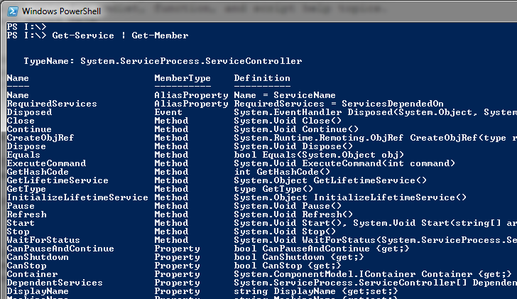
Essential cmdlets
Get-Member
Description: Returns all the properties and methods for an object
Syntax: <cmdlet-name> | get-member
Notes:
Method: Actions (Start, Stop)
Property: State (Started or Stopped)
MemberTypes: http://msdn.microsoft.com/en-us/library/system.reflection.membertypes.aspx

Slide 30
Objects
Objects
Definition: Something we can gather information from and/or perform an action upon. An object, in PowerShell, consists of properties (information we can gather) and methods (actions we can perform).
Car Analogy
Properties | Methods
Color | Accelerate()
Year | Brake()
Make | Coast()
Get-Service
Properties | Methods
Name | Start()
Status | Stop()
Service Type | Pause()

Slide 31
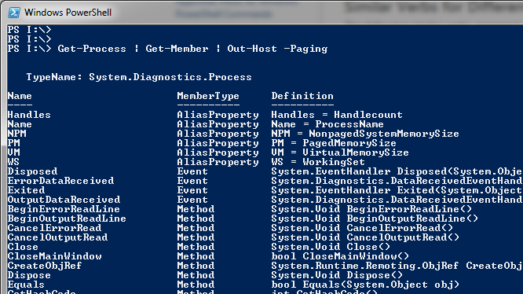
Pipelines
Pipeline –
Definition: A series of commands separated by a pipe operator “|” and each command in the pipeline receives an object from the previous command.
Examples
Get-Process | Get-Member | Out-Host -Paging

Slide 32
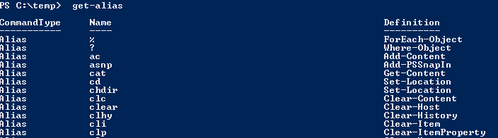
Alias
Alias –
Definition: Another name assigned to a cmdlet, function, script, or executable file.
Considerations
Distributable scripts should use full name
Examples
gc – Get-Content
gwmi – Get-WmiObject
Notes:
148 default aliases

Slide 33
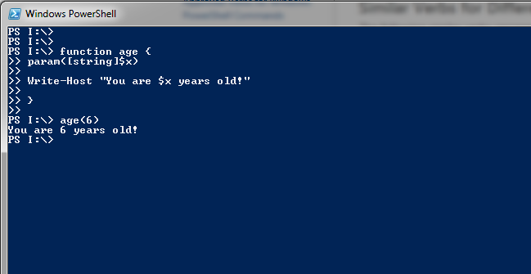
Functions
Functions
Definition: Is a block of code that you name and then can call later to run that block of code
Syntax
FunctionName (parameters) {script block}
Considerations: Must be defined at the top of your script
Example:

Slide 34
Profiles
Profiles
Definition: A PowerShell script file that runs every time PowerShell starts up. Allows for personal customizations to your console.
Content: cmdlets, scripts, functions….
Finding the profile: $profile
Six different types:
Description | Path
Current User, Current Host-console | $Home\[My]Documents\WindowsPowerShell\Profile.ps1
Current User, All hosts | $Home\[My]Documents\Profile.ps1
All Users, Current Host-console | $PsHome\Microsoft.WindowsPowerShell_profile.ps1
All Users, All hosts | $PsHome\Profile.ps1
Current user, Current Host-ISE | $Home\[My]Documents\WindowsPowerShell\Microsoft.WindowsPowerShellISE_profile.ps1
All users, Current Host-ISE | $PsHome\Microsoft.WindowsPowerShellISE_profile.ps1
Notes:
http://blogs.technet.com/b/heyscriptingguy/archive/2013/01/04/understanding-and-using-powershell-profiles.aspx?Redirected=true

Slide 35
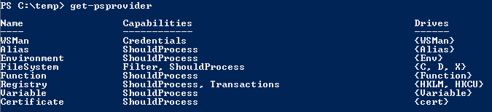
Providers
Providers
Definition - Provides access to data and components that would not otherwise be easily accessible at the command line. The data is presented in a consistent format that resembles a file system drive.
Providers – Registry, ADSI, FileSystem …..
Notes:
Examples: get-childitem hklm:\software

Slide 36
Module 2 Lab: Fundamentals

Slide 37


Task 1 & 2 – Navigating Your System
Task #1 (10 min)
Here’s your task:
Get a listing of all files and folders located in your C:\Windows folder.
Here’s a tip:
The Dir and ls command will do the job; however that’s not what we’re looking for. Although knowing those two commands should get you the cmdlet that we’re looking for.
Task #2 (10 min)
Here’s your task:
Get a listing of all available parameters and examples for the Get-Service cmdlet.
Here’s a tip:
Remember that you have three levels of details that can be returned. Choose your selection wisely!

Slide 38
Task 3 & 4 – Navigating Your System
Task #3 (10 min) !!! BONUS !!!
Here’s your task:
Get a listing of files within the C:\Windows folder on a remote computer
Here’s a tip:
Remember, some cmdlets leverage built –in named parameters! Don’t go crazy, it’s not that hard!

Slide 39
For Wednesday….
Module 3: Pipeline
Pipeline
Comparison Operators
Where-Object
Select-Object
Sort-Object
Format-Table
Format-List
Get-Content
Import-CSV
Add-Content
Set-Content
Export-CSV
Module 4: Scripting
Variables
Arrays
Constants
Looping
Flow Control
Functions
Arguments vs. Parameters

Slide 40
Module 3: Pipeline
Ryan Schlagel

Slide 41
Pipeline
All cmdlets run in a pipeline
Use a cmdlet to retrieve a collection of objects and hand that collection over to a second cmdlet, one that does further processing (filtering, grouping, sorting, etc.)
Uses pipe separator character (|) that separates two commands
Example
Get-Service | Out-Default
Notes:
Suggestions:
Update the description of a pipe to include the handing of an object/collection of objects to another cmdlet Get-Service | Sort-By Name
As your talking, reference that piping is common in Linux/Unix type environments and most network switch/router type environments such as show-interface | grep fc0/3

Slide 42
Comparison Operators
Describes the operators that compare values in PowerShell and finds values that match specified patterns.
-eq = equal to
-ne = Not equal to
-gt = Greater than
-ge = Greater than or equal to
-lt = less than
-le = less than or equal to
-like = match using the wildcard character (*)
-notlike = Does not match using the wildcard character (*)
-match = matches a string using regular expressions
-notmatch = Does not match a string
-contains = Includes an identical value that is not part of a value. Returns a boolean value (true/false)
-notcontains = Does not include an identical value. Returns a boolean value
-replace = Changes the specified elements of a value
Notes:
$a = “dog”
$b = “cat”
$a –eq $b (results equal false)
$a –eq $a (results equal true)
** Point out that when assigning a value to variable, use the = sign instead of the comparison operator. The comparison operator is ONLY used for comparison reason only!

Slide 43
Where-object
Allows us to filter a set of objects out of the Pipeline based on certain criteria.
Example
Filters objects out of the pipeline based on certain criteria
Get-Service | Where-Object {$_.Status –eq “Running”}
{} = Brackets are used with Where-Object filters. These contain a PowerShell script block that will be executed. It works by inspecting each object that is passed into it.
$_ = Special characters that represent each object being transferred across the pipeline.
Notes:
Suggestions:
1) You’ll probably need to give an example that includes something with properties and then provide an example of something without parameters such as Get-Content

Slide 44
Select Object
Used to either return specified properties of an object or return a particular group of objects that have been sorted.
Example
Get-ChildItem C:\Windows\*.* | Sort-Object Length –Descending | Select-Object –First 3

Slide 45
Sort-object
Lists how you want the data sorted, like name, handle status, all are properties you can find by using Get-Member, separated by commas.
Key Parameters
-Property = Determine which property to sort by
-Descending = Default is ascending order, this will change that.
Example
Sorts processes by working set in descending order
Get-Process | Sort-Object –Property WorkingSet –Descending

Slide 46
Format-Table
Allows customization of a table that displays specified properties of objects.
Should be used at the end of the Pipeline
Key Parameters
-Property = Allows the specification of different properties that will be present in the table, separated by commas
-AutoSize = automatically resize the columns of the table so they fit the screen
Example
Displays processes by Handle size
Get-Process | Format-Table -Property Name, Handles -AutoSize

Slide 47
Format-List
Data is presented in the form of a list
Key parameter
-Property - specifies which properties should be displayed in the list with multiple properties separated by commas.
Example
Get-Service | Format-List
Notes:
Suggestion:
- Mention that only a subset of properties return unless you leverage the “*”

Slide 48
Get-Content
Reads the contents of a text file into an array, it reads each line and when it finds a carriage return, moves onto the next element in the array.
Key parameter
-Path
Example
Get-Content -Path C:\Test.txt | Get-Service | Format-Table Name, Status -AutoSize

Slide 49
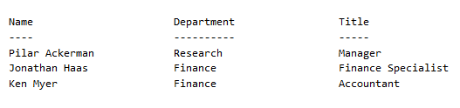
Import-CSV
Reads a csv file and creates objects based on the attributes contained in the file
Example
Import-CSV C:\Scripts\Test.txt
Name,Department,Title Pilar Ackerman,Research,Manager Jonathan Haas,Finance,Finance Specialist Ken Myer,Finance,Accountant
Displayed in Powershell:

Slide 50
Add-Content
Appends content to a simple text file
Key Parameters
-Path = Determines which file to append to
-Value = Specifies what to write to the file
Example
Add-Content -Path C:\MyStuff\Log.txt -Value “Hello"

Slide 51
Set-Content
Writes or replaces the contents of a file
Key Parameters
-Path = Determines which file to append to
-Value = Specifies what to write to the file
Example
Set-Content -Path C:\MyStuff\Log.txt -Value “Hello"

Slide 52
Export-CSV
Exports objects directly to a CSV file
Key Parameters
-Path = File to be exported to
-Delimiter = Specifies which character should be used to separate properties in the file
Example
Get-Process | Export-CSV -Path C:\Text.csv

Slide 53
Convertto-html
Converts objects into HTML tables.
Key Parameters
-Property = used to define the columns for the table.
-CSSUri = Allows a cascading style sheet to be specified which determines the formatting of the html
Example
Get-Eventlog -Logname System | Convertto-HTML -Property EventID > Test.html

Slide 54
Module 3 Lab: Pipeline

Slide 55
Task 1:
Here’s your task:
Use Notepad to create a text file that contains at least thirty lines of text. Then, use
PowerShell to display just the first ten lines.
Here’s a tip:
What command would you use in Cmd.exe to display the contents of a text file? Perhaps
that command is an alias in PowerShell.

Slide 56
Task 2
Here’s your task:
What properties are available for a Service object?
Here’s a tip:
The Get‐Service cmdlet returns a collection of service objects.

Slide 57
Task 3
Here’s your task:
If the pipeline ends in Out‐Default, which produces text on the screen, how do you think
you could have text go into a file instead? For example, how could you send a list of
processes into a file named c:\processes.txt?
Here’s a tip:
If Out‐Default goes to the default display—the screen—then perhaps another Out cmdlet
sends output somewhere else.

Slide 58
Task 4
Here’s your task:
How could you check to see if the contents of a variable named $var contained the
phrase “exec”?
Here’s a tip:
There’s a comparison operator that allows you to use wildcards.

Slide 59
Bonus task
Here’s your task:
Create a folder named C:\Test on your computer. Then, create a text file named
C:\Files.txt. In that file, list three complete file paths and names—one per line—of files
that already exist on your system.
Now, tell PowerShell to copy all of the files listed in C:\Files.txt into C:\Test, using a single
command‐line.
Here’s a tip:
You should already know the commands for reading content from a text file and for
copying items in the file system. You just need to combine them somehow.

Slide 60
Module 4: Scripting
Dustin Giles

Slide 61
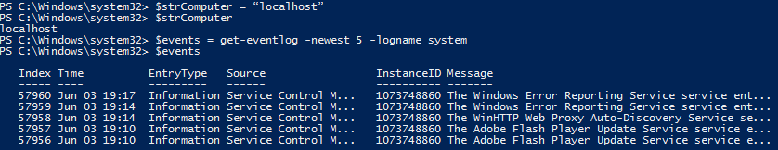
Variables
Variables –
Definition: Single storage location and starts with $ sign in PowerShell. To assign data to a variable use a “=“.
Considerations
Define variable type “[string]”
Add prefix based on variable type – Str, Arr, Bln
Examples
$strComputer = “localhost”
$events = get-eventlog -newest 5 -logname system
Notes:
What: storage location that will be later utilized in the script. It will start with a $ and assigns data with = and not to be confused with compare operator –eq.
Why: Think of a variable as a imaginary box where information is stored and allows us to use that later on in a script or as a result of script.
How : look at examples
Considerations:
[string]
Add type prefix
Str
Arr
Bln

Slide 62

Arrays
Arrays -
Definition: Multiple variables index to a specific value (0),(1), and so on. An array is noted by @ symbol.
Use case examples:
Cleanliness
Associated Properties (Count)
Example
$arrComputers = @(“Server1″, “Server2″, “Server3″)<enter>
@(Get-Services).count
Notes:
What: Imagine an array as storage box with multiple locations to store the data starting with specific value of 0, 1, 2 ect and in powershell they are assigned with an @ symbol
Why: We use arrays to make a collection of data we can later process such as a grouping of servers instead of having a messy list of variables
How:
May want to include alternate ways of defining / forming an array
Something Cool: @(Get-Service).Count

Slide 63
Constants
Constants –
Definition: A special type of variable that cannot be changed after creation.
Use Cases
Static / Predictable Variables
Database Connection Strings
Unique / Expected Variable Aliases
Considerations
When referencing a variable within a cmdlet string, do not enter the dollar sign ($)
Example
Set-Variable –Name Pi –value 3.142 –option constant
Notes:
What: constants are a special kind of variable that cannot be changed.
Why: Even though I do not use this often it would find purpose in a robust where you do not want something change like a sql connection string that will remain the same throughout the script.
Note :when setting the variable it does not use a $ but when it is called it does like any other constant
How:

Slide 64
Looping
Looping –
Definition: Process that allows us to repeat a command and process large amounts of data.
Use Cases
Loop through collections, arrays, lists, datasets, datatables, etc.
Different types
do while - Script block executes as long as condition value = True.
while - Same as “do while.”
do until – Script block executes until the condition value = True.
for – Script block executes a specified number of times.
foreach - Executes script block for each item in a collection or array.
Notes:
What: Looping is the process to repeat a command and process large amounts of data
Why: Think of having an array of computers that you would like to get data from such as finding it C: size and free space
How: different types

Slide 65
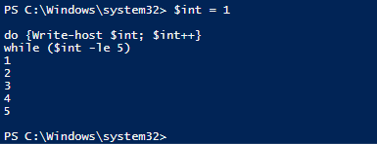
Looping - Examples
Do While –
Syntax:
do {code block} while (condition)
Example

Slide 66
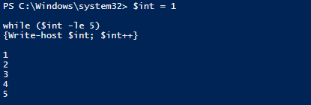
Looping - Examples
While –
Syntax:
while (condition)
{code block}
Example
Notes:
Notice the only difference is the placement of the while statement

Slide 67
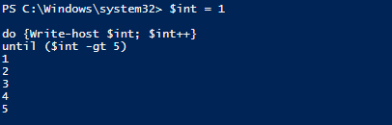
Looping - Examples
Do until –
Syntax:
do {code block} until (condition)
Example
Notes:
Do until is the opposite of the do while since it executes the code block until the condition is true

Slide 68
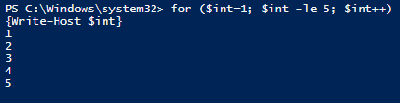
Looping - Examples
For –
Syntax:
for (initialization; condition; repeat) {code block}
Note: It is important to know the order of initialization; condition; repeat -or this could lead to an infinite loop. (In the case of infinite loop remember “Ctrl + C”)
Example
Notes:
Note: each of the three parameters are optional.
initialization - one or more commands, separated by commas, that run before the loop begins. Commonly used to create and initialize a variable with a starting value. This variable is the basis for the condition to be tested in the next portion of the for statement.
Condition – Resolves to a Boolean True or False value. PowerShell evaluates the condition each time the loop runs. If the condition is True the code block is executed, then the condition is tested again.
Repeat – one or more commands, separated by commas, that run each time the loop repeats. Commonly used to modify a variable that is tested inside the “condition” portion of the for statement.

Slide 69
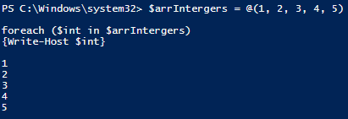
Looping - Examples
Foreach –
Syntax:
foreach ($<item> in $<collection>)
{code block}
Example
Notes:
Probably my most used
Get-Content -Path C:\Test.txt | Get-Service | Format-Table Name, Status -AutoSize
$Servers = Get-Content –Path C:\Test.txt
Foreach ($Server in $Servers) {
Write-Host $Server –foregroundcolor green
}
Possible show this with get-content with txt file with list of
Server1
Server2
Server3

Slide 70
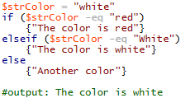
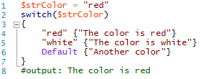
Flow Control
Flow control – “If” statements and “Switch” Statements.
Definitions
“If” statement is a piece of code that will execute if a condition evaluates to true. “ElseIf” and “Else” statements are used if multiple conditions are evaluated against.
“Switch” statements is a piece of code that checks for a condition and a different piece of code will be executed depending on the which condition is matched.
Examples
If/Else Statements | Switch Statements
Notes:
What: If statement is a piece of code that will execute if a condition is true. If statements can be used with else if and else statements it there is multiple conditions to be evaluated against,
Switch statement is like the case statement in Vbscript which a piece code that checks for a condition and executes a piece of code depending on which condition is met.
So what is the difference? Well an if statement will stop when a condition is met where as the switch statement will execute all that meet the condition. Also, an if statement can check for multiple compare operators such as equals, like, great than, ect.
How:Examples and ISE
Switch statement same as Case statement in VBScript
What is the difference between a Switch statement and If/Else statement
Switch statement will execute multiple “true” statements whereas the If/Else statement will only execute the first “true” statement it evaluates against.
If/Else statement supports multiple comparison operators
switch (10)
{
(1 + 9) {Write-Host "Congratulations, you applied addition correctly"}
(1 + 10) {Write-Host "This script block better not run"}
(11 – 1) {Write-Host "Congratulations, you found the difference correctly"}
(1 – 11) {Write-Host "This script block better not run"}
}
$name = 2 #creates a variable name and assigns 2 as the value
if ($name -eq 5) {Write-Host "Hello my name is Chad - I love powershell"}
elseif ($name -eq 4) {Write-Host "Hello, my name is Ryan! This training is great!"}
elseif ($name -eq 2) {Write-Host "Hello, my name is Dustin! I hope you are enjoying this training!"}
elseif ($name -gt 1) {Write-Host "Hello, my name is Dave- you are doing great!"}
else {"I have no idea what my name is?"}

Slide 71
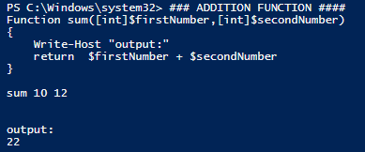
Functions
Functions –
Definition: Self contained module of code that typically perform a single task. Think of them as mini-cmdlets that you write using PowerShell scripting language. Functions can be defined within any scope (Shell, Script or within another function).
Considerations
Functions must be defined before they are called upon at the top of the script
Sytnax
Function FunctionName (parameters) {script block}
Example
Notes:
What: Self contained module that performs a task. Think of them as mini-cmdlets. These must be defined before called typically at the top of the script since powershell runs top down.
Why: Functions allow us to rerun the same task multiple times once defined
Show examples
Function sum([int]$firstNumber,[int]$secondnumber) #parameters
A function allows you to name a block of code. The code block can then be called (by its name) once or multiple times anywhere from within your script.
{
Write-Host "output:"
return $firstNumber + $secondnumber
}
Function Time {Get-Date}

Slide 72
Command line arguments - $Args vs Param()
Command line arguments - $Args vs Param()
Definitions
$Args is used for positional parameters and is simply an array that is automatically generated every time a script is run and contains all text that is supplied after the name of the script.
Param($x,$y) or named parameters issued at the beginning of a script to specify what parameters should be supplied to the script.
Examples
$Arg - Positional Parameters | Param() - Named Parameters
Passed to script with spaces | Passed to script with parameter name
.\script.ps1 server1 Jon | .\script.ps1 -user Jon –server server1
Accessed in script by $args array | User Parameter name directly in script
$servername = $args[0] $username = $args[1] | Param($server, $user) Write-Host $server Write-Host $user
Notes:
What: $Args or arguments are used as positional parameters and with these parameters a predefined script will generate results based on the parameters passed.
Whereas Param() is a named parameter that will is issue at beginning of script based on the supplied parameters.
Why: These are very useful for entering variables to a script without hard coding them into it. For example you have a script that you want to find all the servers for a certain platform team that are deployed so you would have two parameters one for the platform support group and status for deployed but you do not care what the underlying code is but you may want to switch the platform support group from windows-legal-int to windows-tax-cust. So with this you would be able to that straight from the command prompt without touching the hard written code.
How: show example and ISE
Suggestions
Show example of how to call using args and params
Document how to code args and params

Slide 73
Module 4 Lab: Scripting
Dustin Giles

Slide 74
Task 1 – Using Variables
Task #1 (10 min)
Here’s your task:
Create a variable named $var and have it contain the phrase “Hello World.” Then, create
a second variable named $var2 which contains the phrase “I say,” a space, and then the
contents of $var..
Here’s a tip:
You may not have learned this yet, but when PowerShell sees a variable inside double quotes, it replaces the variable with its contents. It does not do this for single quotes..
Notes:
Here’s the solution script:
$var = "Hello World"
$var2 = "I say, $var"
$var2

Slide 75
Task 2 – Using Arrays
Task #2 (10 min)
Here’s your task:
Create an array named $arrColor, containing the words “one,” “two,” and “three.” Display
only the elements of $arrColor which are fewer than four characters in length, and have them
displayed in green.
Here’s a tip:
You’ll need to use three cmdlets in your final command‐line in order to make this work.
Here’s a tip:
String types have a property which indicated how many characters the string contains.
Pipe a string to Get‐Member to try and locate this property and discover its name.
Notes:
Here’s the solution script:
$arrColor = @("one","two","three")
$arrColor | where { $_.Length -lt 4 } | Write-Host -foregroundcolor green

Slide 76
Task 3 – Using Scripting Constructs
Task #3 (10 min)
Here’s your task:
Write a script that will search for an event log filename system, and then retrieves the
newest 50 events from that event log.
For each event, examine the category. If the category is (0), output the event’s “time
written” in green. If the category is (101), output the time in yellow. If the category is
(103), output in Red. For all other categories, output in white.
Here’s a tip:
Use Get‐Member to find the property names you need.
Use Get‐EventLog, piped to Format‐List, to display all the properties so that you can see
what values go into these properties.
Use the scripting constructs you just learned, and take things step‐by‐step to construct a
script that accomplishes the task as described.
Notes:
Here’s the solution script:
$events = Get‐EventLog -Logname System ‐Newest 50
foreach ($event in $events) {
switch ($event.category) {
"(0)" { $color = "Green" }
"(101)" { $color = "Yellow" }
"(103)" { $color = "Red" }
default { $color = "White" }
}
Write‐Host $event.timewritten ‐foregroundcolor $color
}

Slide 77
Module 5: Security
Ryan Schlagel

Slide 78
Execution Policy
Built in security mechanism to make it a trustworthy scripting environment.
Example
Get-ExecutionPolicy = Returns current setting
Set-ExecutionPolicy = Set the appropriate value
ByPass
Remote signed = Downloaded scripts from the Internet must be signed by a trusted publisher before they can be run.
All signed = Only scripts signed by a trusted publisher can be run. And any scripts not signed will not be run.
Notes:
Add conversation around scope

Slide 79
Module 5 Lab: Security
Wendy Peterson

Slide 80
Module 6: Object Models
Dustin Giles

Slide 81
.Net framework
.Net framework –
What is it? Middleware to access lower level Operating System's low level code at a cost of performance but in a simpler object oriented way.
Prior to .Net framework developerss had to be very familiar with windows internals and the win32 api subsystem.
After .Net framework scripters only need to understand object orientated techniques and to MSDN.
Notes:
What: is middleware to access lower level operating systems code.

Slide 82
Windows forms
Is an object created by using objects from .Net Framework

Slide 83
Objects - COM
Neat!
$s = New-Object -ComObject SAPI.SpVoice
$s.rate = -10
$s.speak("Too much pop makes you drunk")

Slide 84
Class and Object
Class - is a template of an object
Examples
Object - is an instance of a class.
Examples

Slide 85
WMI
WMI- is the implementation of 2 standards: CIM and WBEM and uses namespace or logical grouping of objects of a similar technology.
CIM stands for Common Information Model.
WBEM is a standard for making this available remotely.

Slide 86
Get-WMIobject
Get-WMIobject- is cmdlet that gets instances of WMI classes.
Get-WMIObject cmdlet does not use Powershell remoting infrastructure to perform remote operations.

Slide 87
Module 6 Lab: Object Models
Dustin Giles

Slide 88
Module 7: PowerShell Remoting
Ryan Schlagel

Slide 89
Remoting Technologies
Remote Procedure Call (RPC) and DCOM
WMI
WS-MAN (Web Services Management) = Powershell Remoting
Windows Remote Management (WinRM) is Microsoft’s implementation of WS-Management protocol
Whatever runs locally should be able to be run anywhere.

Slide 90
WMI
WMI can be accessed by the following command:
Get-WMIObject cmdlet

Slide 91
Computername Parameter
Parameter used to connect to clients
Get-Process with -computername = uses RPC and DCOM to connect to client
Get-WMIObject uses WMI remoting technology
Enter-PSSession uses Powershell remoting

Slide 92
Hardware and other operating systems
If the hardware supports WS-MAN, then certain scenerios can be managed directly by Powershell. Windows Remote Management is used.
Power control
HW/SW inventory
Alerts
Manage bios
Software and firmware updates
Health monitoring

Slide 93
Configuring Powershell Remoting
From powershell run Enable-PSRemoting
This performs the following:
Runs the Set-WSManQuickConfig cmdlet
Starts the WinRM Service and sets it to Automatic
Creates a listener to accept requests on any IP address
Enables a firewall exception for WS-Management communications
Enables all registered Powershell sessions configurations to receive instructions from a remote computer.
Only need to run this command once.
Could also set this up using GPOs.
To test run winrm id -r:<servername>

Slide 94
PS Sessions
A session is an environment in which a Powershell runs. Remote sessions can also be created.

Slide 95
Remote Architecture
Remote shells are object oriented.
Objects are created on the remote machine, then serialised and sent back using SOAP (Simple Object Access Protocol).
TCP port 5985 is used.
All communication is made using the WS-MAN protocol and is encrypted.

Slide 96
Interactive Sessions
Enter-PSSession cmdlet starts an interactive session with a single remote computer
Commands run are run on that computer.
You can have only 1 interactive session at a time.
To end the session, type Exit.

Slide 97
Persistent Sessions
New-PSSession creates a Powershell persistent session on a local or remote computer.
You can use this to run multiple commands that share data, such as a function or the value of a variable.
To run these commands, use the Invoke-command cmdlet. This command opens a session for running commands remotely and then closes it once the execution is complete.
To interact directly with the remote computer, use Enter-PSSession cmdlet. Commands you type run on the remote computer.

Slide 98
Remoting To Multiple Computers
Use Invoke-Command - runs commands on local or remote computer (Invoke-command -Computername).
To run a series of commands on a remote computer, create a PSSession (persistent) first and then use Invoke-command session parameter.

Slide 99
Jobs
Powershell runs commands asynchronously, meaning that many jobs can be run in parallel across multiple endpoints.
The method to track these are jobs.
These jobs run in the backgroup.
Use Receive-Job cmdlet to get the results of the job.

Slide 100
Starting Jobs
Start-job cmdlet starts a Powershell background job on the local or remote computer.
Run Get-Job cmdlet to get all jobs in the current session that are running in the background.
To get the job results, run Receive-job cmdlet.
Run a background job if you are running a complex command that takes a long time to run.

Slide 101
Receiving Job Data
Receive-Job cmdlet gets the results of a Powershell background job.

Slide 102
Job Completion
Wait-job cmdlet waits for Powershell background jobs to complete before displays a command prompt.
Stop-job - cmdlet will stop a Powershell background job that is in progress.
Remove-job cmdlet will delete a job.

Slide 103
Throttling
Commands can be throttled which limits the amount of concurrent connections.
Throttling applies to only the current command, not the session or the computer.
The default throttling limit is 32 and can be changed with the -throttlelimit parameter.

Slide 104
Module 7 Lab: PowerShell Remoting
Wendy Peterson

Slide 105
Module 8: Error Checking and Debugging
Dustin Giles

Slide 106
Using write-debug
Using write-debug - cmdlet that writes text to the console windows to help understand how a program is running.
Controlled by a variable $DebugPreference

Slide 107
$DebugPreference
$DebugPreference - global variable that defines how to a program runs with write-debug.
There are 4 valid values:
$DebugPreference = "Continue"
Displays Write-Debug output to the console window.
$DebugPreference = "Stop"
Displays Write-Debug output then stop the script.
$DebugPreference = "SilentlyContinue"
Hides ay debug output from Write-Debug and contine executing the script.
$DebugPreference = "Inquire"
Prompts with what action to proceed with when Write-Debug occurs.

Slide 108
Key debugging functions of ISE
Toggle Breakpoint
Step Over
Step Into
Run/Continue
Stop Debugger
Display Call Stack

Slide 109
How Errors Work
Two Types
Terminating
Non-Terminating
Written to a clobal variable called $Error
An array of 256 entries
Each error is an object with a set properties that can queried.

Slide 110
ErrorActionPreference
There are 4 valid values:
"Continue" - Displays Write-Debug output to the console window
"Stop" - Displays Write-Debug output then stop the script.
"SilentlyContinue"- Hides ay debug output from Write-Debug and contine executing the script.
"Inquire“ -Prompts with what action to proceed with when Write-Debug occurs.

Slide 111
Handling Errors
Clear $Error
Calling $Error

Slide 112
Try… Catch…Finally
Try...catch…finally
Statement can be used to handle terminating errors.

Slide 113
Module 8 Lab: Error Checking and Debugging
Dustin Giles

Slide 114
Module 9: Active Directory and SQL
Ryan Schlagel

Slide 115
Module 9 Lab: Active Directory and SQL
Ryan Schlagel

Slide 116
Module 10: Resources
Ryan Schlagel

Slide 117
Module 10 Lab: Resources
Ryan Schlagel

Slide 118
Resources
Script Editors
Dell / Quest PowerGUI | A free script editor that doubles as a fully-extensible administrative console. http://www.quest.com/powergui-freeware/
Cmdlets and Software
/n Software NetCmdlets | Scores of cmdlets that do everything from send SMTP or POP mail to ZIP files. http://www.nsoftware.com/powershell
PowerGadgets | Display Windows PowerShell output as graphs, charts, gauges, maps, etc. http://www.softwarefx.com/sfxSqlProducts/powergadgets/
PowerShell Community Extensions | Cmdlets, providers, and add-ins created by members of the Windows PowerShell Community. http://www.codeplex.com/PowerShellCX
SDM GMPC Windows PowerShell Cmdlets | Windows PowerShell cmdlets for working with the Group Policy Management. http://www.sdmsoftware.com/freeware.php
Specopsa Command | Use Group Policy as a mechanism for delivering and executing Windows PowerShell scripts. http://www.specopssoft.com/products/specops-command
Notes:
http://technet.microsoft.com/en-us/scriptcenter/ee861518.aspx

Slide 119
Resources
Books
Windows PowerShell Cookbook, Second Edition | Microsoft’s Lee Holmes brings you hundred of “recipes” explaining how you can use Windows PowerShell to do everything from monitor a file or folder to managing services to manage Active Directory. http://shop.oreilly.com/product/9780596801519.do
Windows PowerShell Course Book | Frank Koch’s free book provides “An introduction to scripting technologies for people with no real background knowledge. https://blogs.technet.com/chitpro-de/archive/2007/05/10/english-version-of-windows-powershell-course-book-available-for-download.aspx
Windows PowerShell in Action | The inside scoop on Windows PowerShell from Bruce Payette, co-designer of the Windows PowerShell language. http://www.manning.com/payette/
Windows PowerShell Step-by-Step | Ed Wilson’s self-paced tutorial is designed to take you from Windows PowerShell newbie to Windows PowerShell aficionado in just a few easy lessons. http://bit.ly/edwilsonpowershellstepbystep
Windows PowerShell: TFM | The ubiquitous Don Jon Jones and Jeffrey Hicks were first out of the gate with their recently-updated book on Windows PowerShell. http://www.sapienpress.com/powershell2.asp

Slide 120
Resources
Web Sites
CodePlex | An open source community web site featuring Windows PowerShell extensions and add-ins. http://www.codeplex.com/Project/ProjectDirectory.aspx?TagName=powershell
Keith Hill’s Blog | Don’t miss Keith’s “Effective PowerShell” series. http://keithhill.spaces.live.com/
PowerShellCommunity.org | A new website featuring community-powered blogs, wikis, forums, and sample scripts, as well as news and events regarding Windows PowerShell and the Windows PowerShell Community. http://powershellcommunity.org/
Precision Computing | Random musings (and sample code, tons of sample code) from Lee Holmes, Windows PowerShell developer and author. http://www.leeholmes.com/blog/
PowerShell.com | Known for their “PowerShell Tip of the Day”, PowerShell.com is a community driven educational forum for everyone to learn PowerShell. http://www.powershell.com
Under The Stairs | From Thomas Lee, one of the top contributors to MSDN’s community content. http://tfl09.blogspot.com/
Windows PowerShell Team Blog | The official word on Windows PowerShell, with regular posts from Jeffrey Snover and other members of the Windows PowerShell team. http://blogs.msdn.com/powershell/
Windows PowerShell Wiki | An outstanding collection of Windows PowerShell scripts, articles, links and other resources. http://technet.microsoft.com/library/bb978526.aspx

Slide 121
Module 11: Scripting Editor
Ryan Schlagel

Slide 122
Module 11 Lab: Scripting Editor
Ryan Schlagel

Slide 123
Module 12: Source Repository
Dustin Giles

Slide 124
Module 12 Lab: Source Repository
Dustin Giles

Slide 125
What’s New With PowerShell 3.0
Ryan Schlagel

Slide 126
System Requirements For Powershell 3.0
Windows PowerShell 3.0 runs on the following versions of Windows.
Windows 8
Windows Server 2012
Windows® 7 with Service Pack 1
Windows Server® 2008 R2 with Service Pack 1
Windows Server 2008 with Service Pack
More System Requirements For Powershell 3.0
.Net 4.0 or higher
WS-Management 3.0
WMI 3.0

